Slide 1
STAY DATA
STAY
WELCOME
Privacy protection for travelers
SEMESTER II PROJECT
Presented by Kiona Wilson
01
Notes:
[object Object],[object Object]

Slide 2
One room. Two guests.
THE MOMENT AFTER CHECKOUT
11:00 AM
NETFLIX
KIONA
HOURS LATER
CHECKOUT
A new guest checks in.
The room resets. The session may not.
02
Notes:
[object Object],[object Object]

Slide 3
A digital checkout list.
HOW STAY DATA STAY WORKS
01
02
03
TRIP DETAILS
→
ACCOUNTS USED
→
FINAL CHECKPOINT
Hotel • room • stay length
Select only what you logged into
Know exactly what to sign out of
Built in Python • input • conditionals • loops • validation
03
Notes:
[object Object],[object Object],[object Object]

Slide 4
SECURITY DOESN’T ALWAYS
LOOK LIKE A HACKER.
NETFLIX
YOUTUBE
Sometimes it looks like one final reminder before the door closes.
EMAIL
PRIME
✓ LOG OUT BEFORE CHECKOUT
STAY DATA STAY
04
Notes:
[object Object],[object Object],[object Object],[object Object]

Slide 5
From protecting a traveler’s
digital footprint…
DeRe
x
i
POLICY PILOT
NEXT CHAPTER
…to helping an entire organization
act on trusted guidance.
05

Slide 6
DeRe
x
i
POLICY PILOT
EMPLOYEE QUESTION
“I clicked a phishing link.
What do I do next?”
Trusted policy guidance.
Clear ownership.
Faster incident action.
→ Immediate steps
→ Escalation guidance
→ Correct policy owner
06
Notes:
[object Object]

Slide 7
The gap DeRexi is designed to close.
THE PROBLEM
01
POLICY EXISTS
02
ANSWER IS UNCLEAR
But employees may not know where to find the answer.
Policies can be vague, outdated, or incomplete.
03
OWNER IS UNKNOWN
04
INCIDENT HAPPENS
Employees may not know who owns the policy.
The first few minutes should not be spent searching.
07
Notes:
[object Object]

Slide 8
One assistant. Four connected workflows.
WHAT DEREXI DOES
01
02
03
04
ASK
ANSWER
ROUTE
RESPOND
Employee asks a policy question.
DeRexi retrieves trusted guidance.
Owner + department are surfaced when clarification is needed.
Incident Assistance provides immediate steps and escalation.
08
Notes:
[object Object]

Slide 9
Built around the people who actually use policy.
THE DEREXI DIRECTORY
D
L
T
M
H
DANA
LUCY
TOM
MAYA
HR
Policy Owner
System Administrator
New Employee
Marketing Associate
HR Representative
COMPLIANCE
TECHNOLOGY
OPERATIONS
MARKETING
HUMAN RESOURCES
Current development focus: realistic employee records, departments, job titles, system roles + policy ownership.
09
Notes:
[object Object]

Slide 10
12 weeks from concept to release.
CAPSTONE ROADMAP
01
02
03
04
05
06
Planning
System Design
Database + Backend
Document Mgmt
AI Search
Employee UI
07
08
09
10
11
12
Email + Routing
Incident Assist
Integration + Security
Testing
Documentation
Release
NOW → database foundation + directory build
10
Notes:
[object Object]

Slide 11
What will “finished” look like?
✦
POLICY LIBRARY
✦
TRUSTED Q&A
✦
CLARIFICATION
Versioned policies + ownership
Answers grounded in approved content
Employee email preview + routing
✦
POLICY HEALTH
✦
INCIDENT ASSISTANCE
✦
SECURE ACCESS
Feedback and ambiguity signals
Immediate steps + escalation
Authentication + role-based permissions
11
Notes:
[object Object]

Slide 12
Two projects. One security philosophy.
STAY DATA STAY
DEREXI: POLICY PILOT
Build the habit
before the risk.
Make the right action
easier to find.
Security that works with people—not against them.
12
Notes:
[object Object]

Slide 13
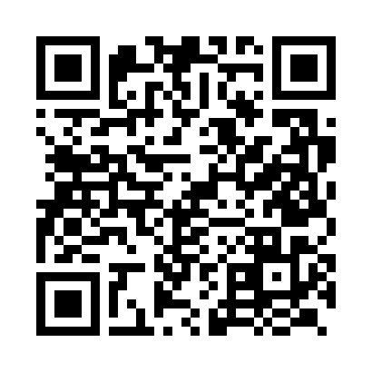
THANK YOU
Stay connected.
Scan to explore my portfolio, projects, and professional links.
Portfolio • LinkedIn • GitHub
SCAN TO CONNECT
kawilson120@gmail.com
Field Day • September 17, 2026
13
Notes:
[object Object]

